Slide 1



Netflix
Evaluation off Netflix Movies.
What factors affect this?

Slide 3


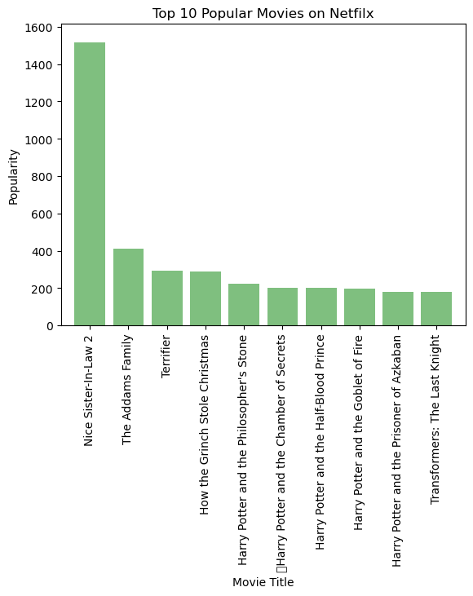

Top 10 Popular Movies.

Slide 4
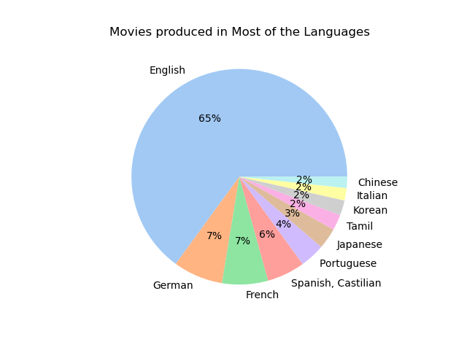
Movies Produced in Most Languages.
English
German
French
Spanish
Portuguese
Tamil
Korean
Italian
Chinese

Slide 5
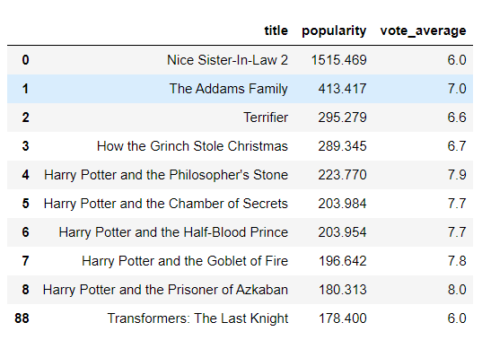
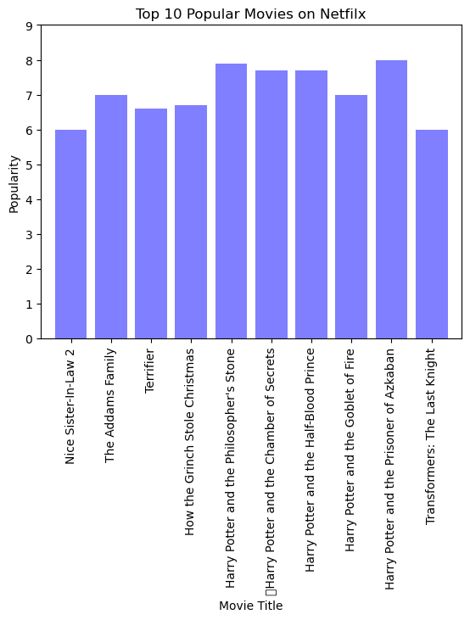
Vote count of Netflix Movies

Slide 6
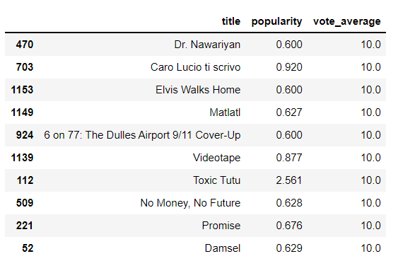
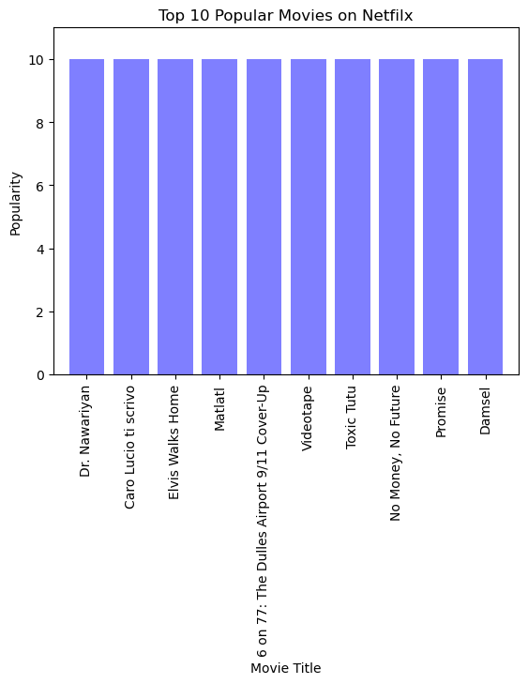
Vote count of Netflix Movies

